Slide 1
Linear Regression

Slide 2
Learning Goals
What is regression?
Why regression?
Scatter plot
Measures of association
Correlation coefficient
Simple linear regression
Fitting a regression line
Notes:
2

Slide 3
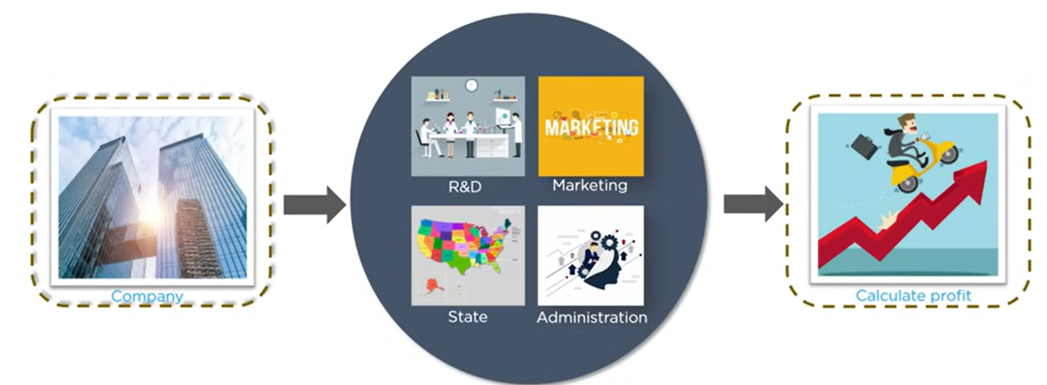
Profit Estimation of a company

Slide 4
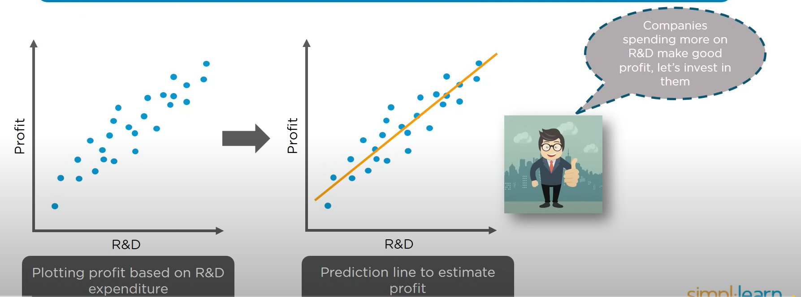
The simplicity let us consider a single variable R& D

Slide 5
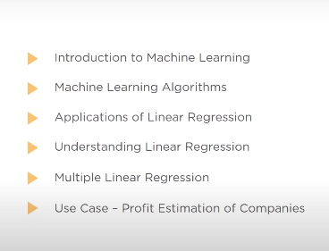
what is important

Slide 6
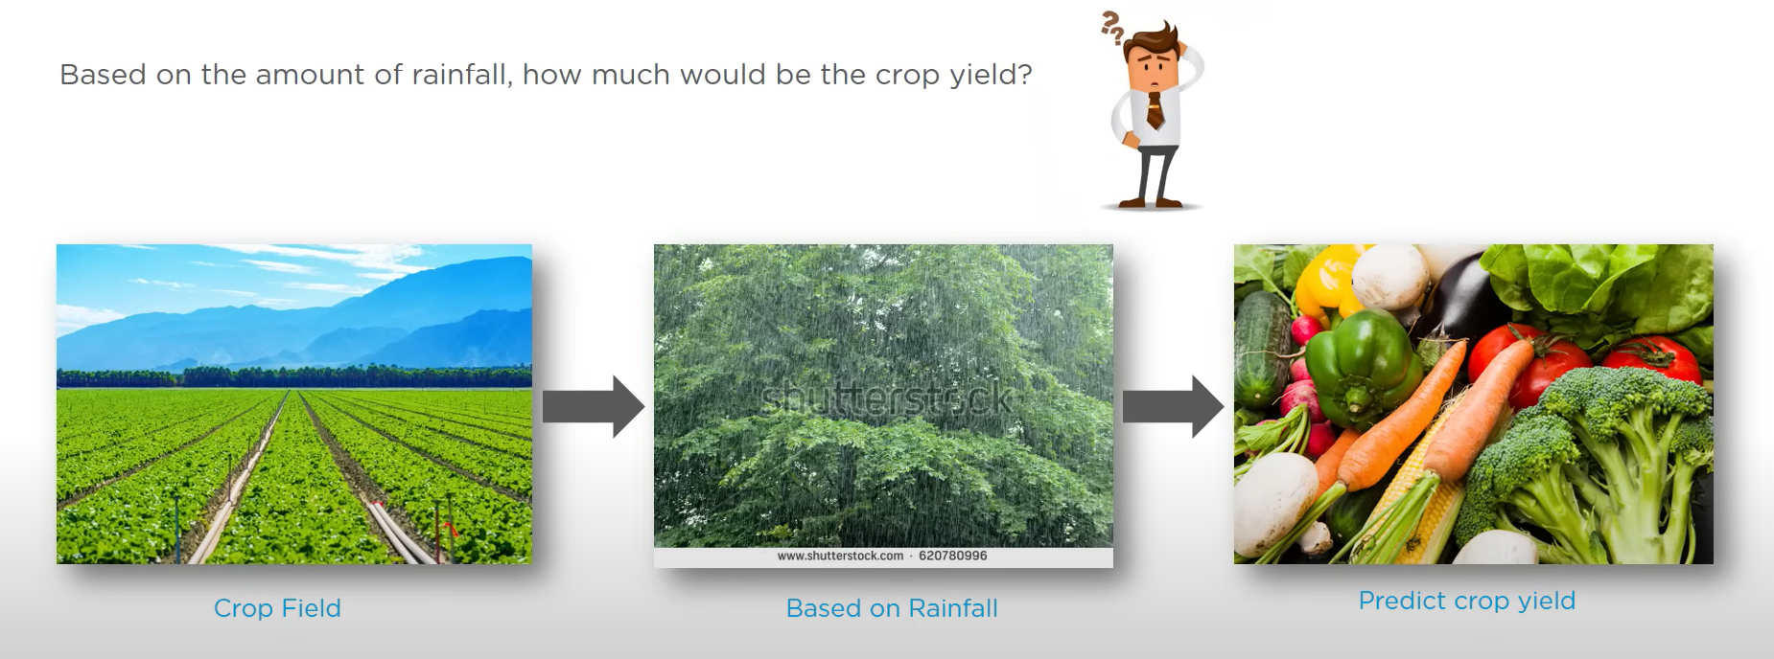
Introduction to Machine Learning

Slide 7
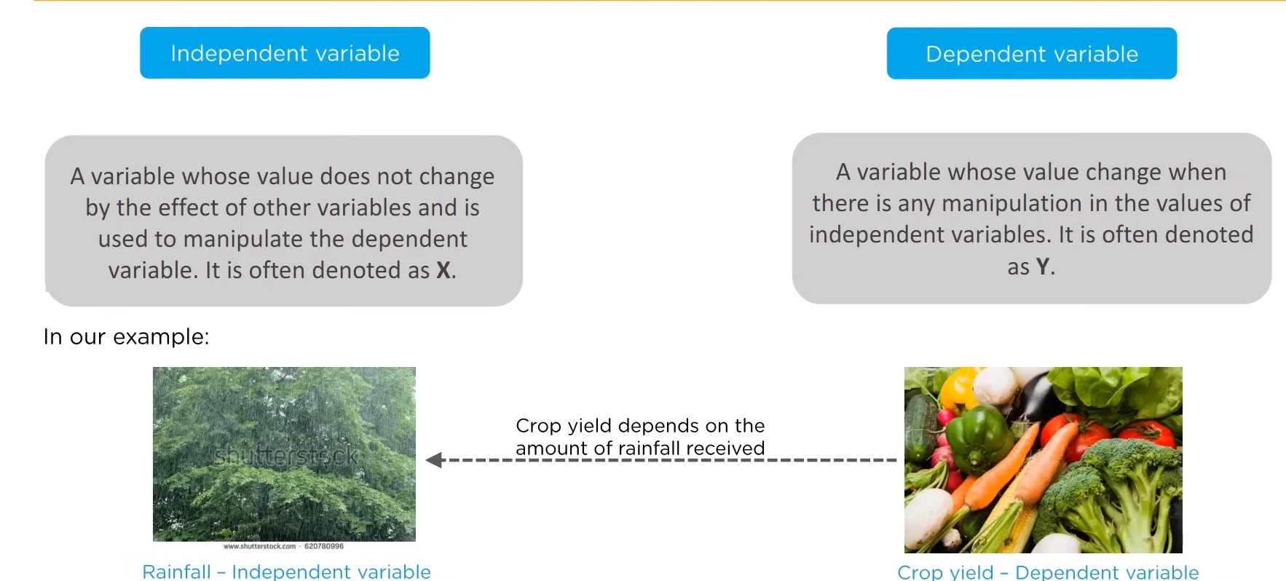
Independent Variable and Dependent Variable

Slide 8
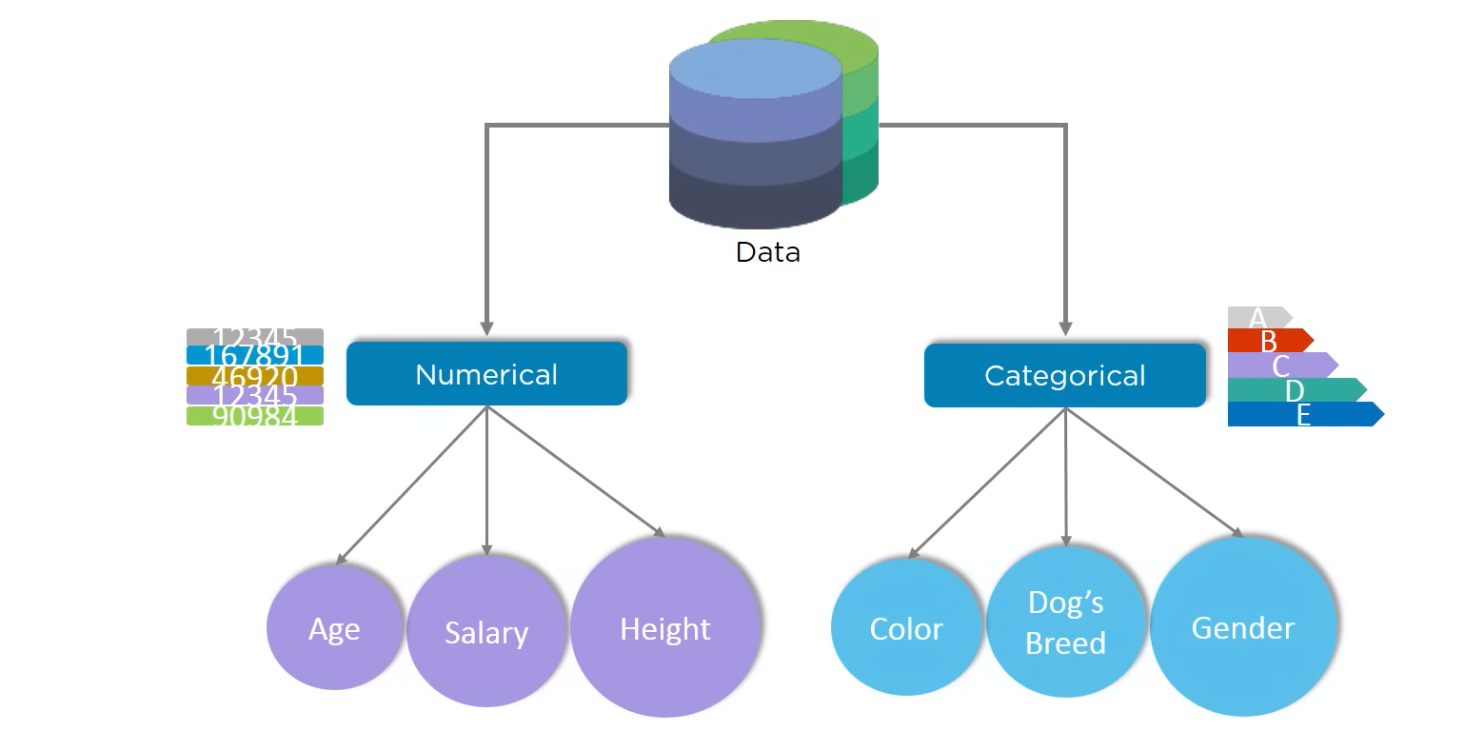
Numerical and categorical Algorithm

Slide 9
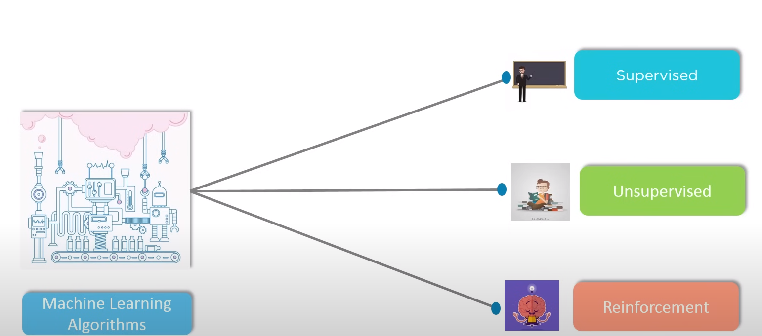
Different Machine Learning Algorithm

Slide 10
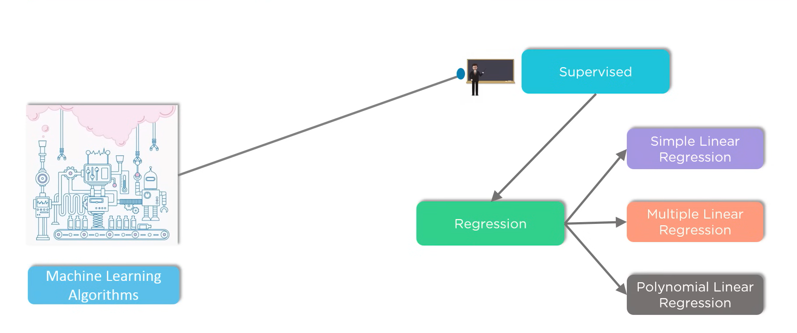
Machine Learning Algorithm

Slide 11
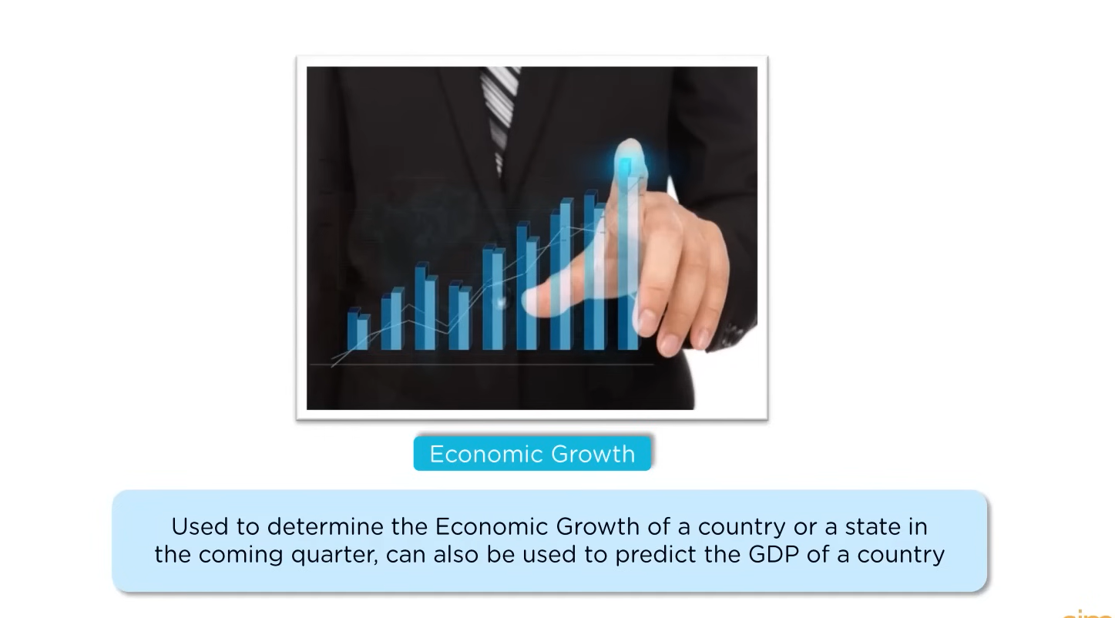
Applications of Linear Regression(Economic Growth)

Slide 12
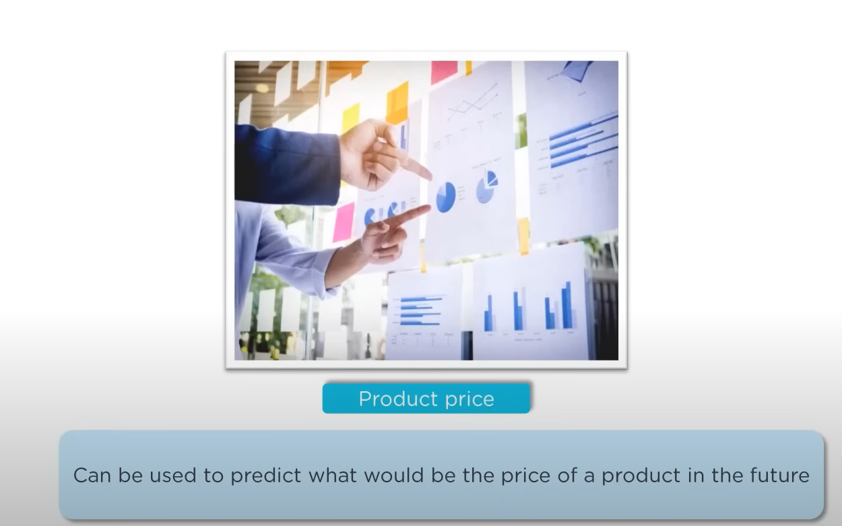
Applications of Linear Regression cont..( Product Price)

Slide 13
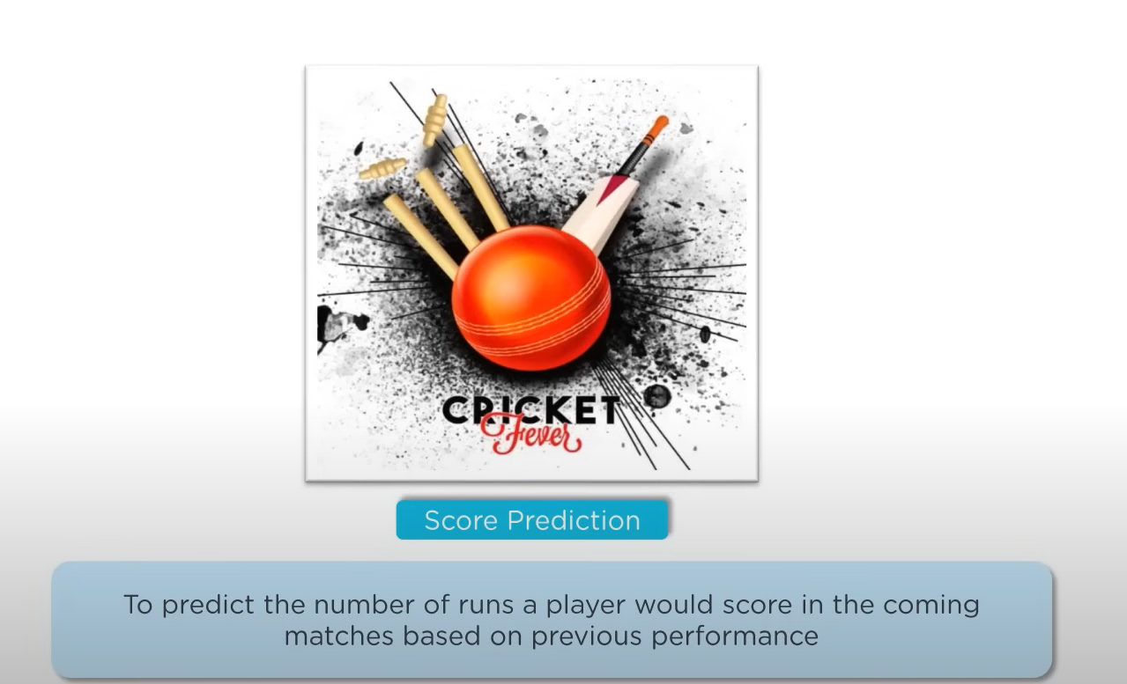
score Prediction

Slide 14
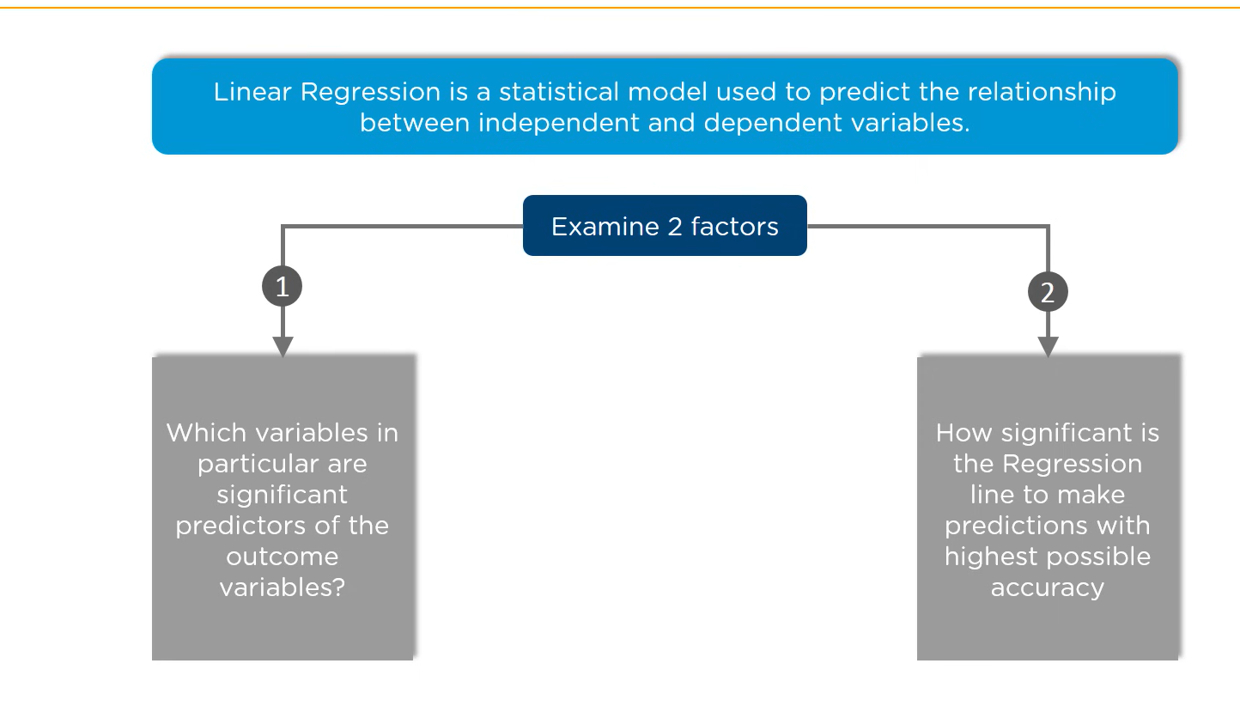
Linear Regression

Slide 15
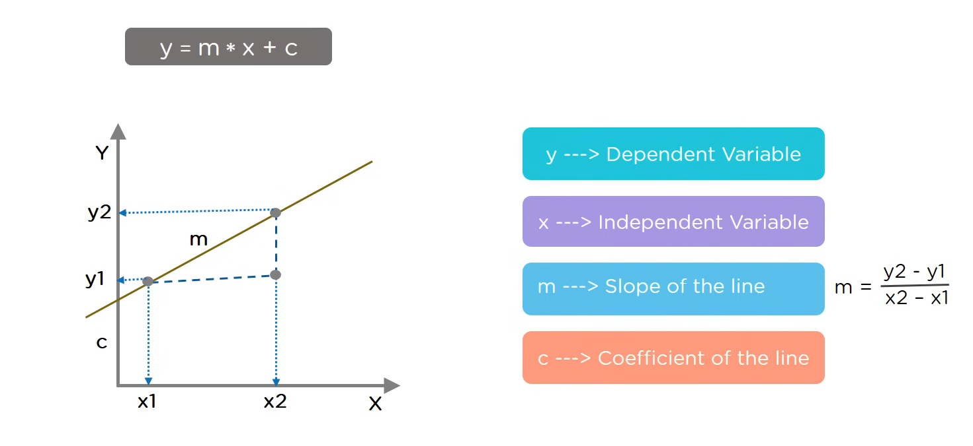
Simple Linear Regression Equation

Slide 16
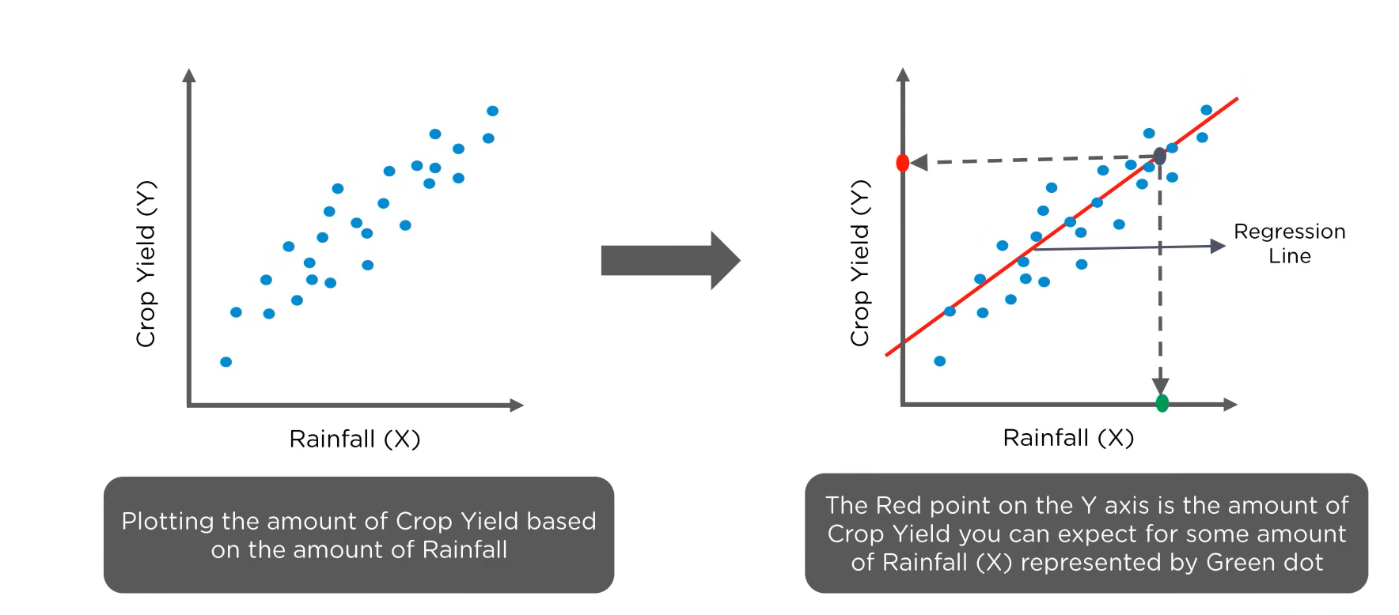
Prediction Using Regression Line

Slide 17
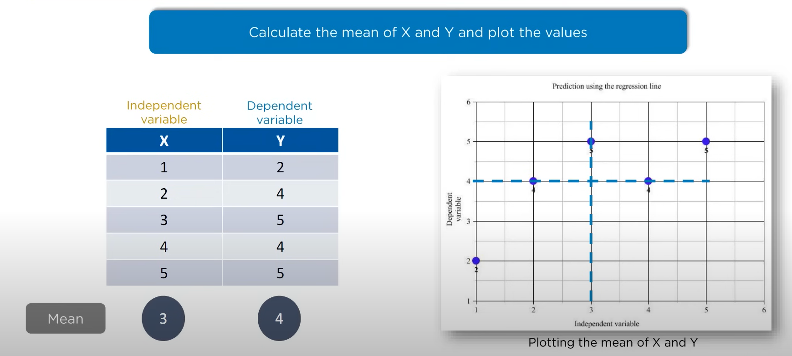
Explain Regression Concept

Slide 18
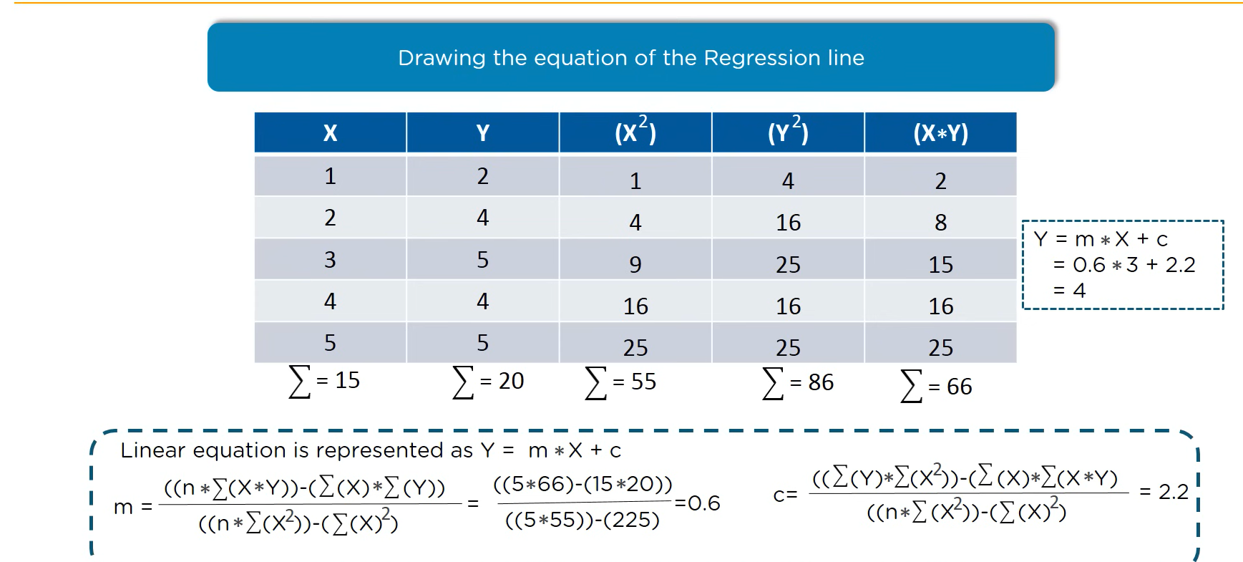
Cont…

Slide 19
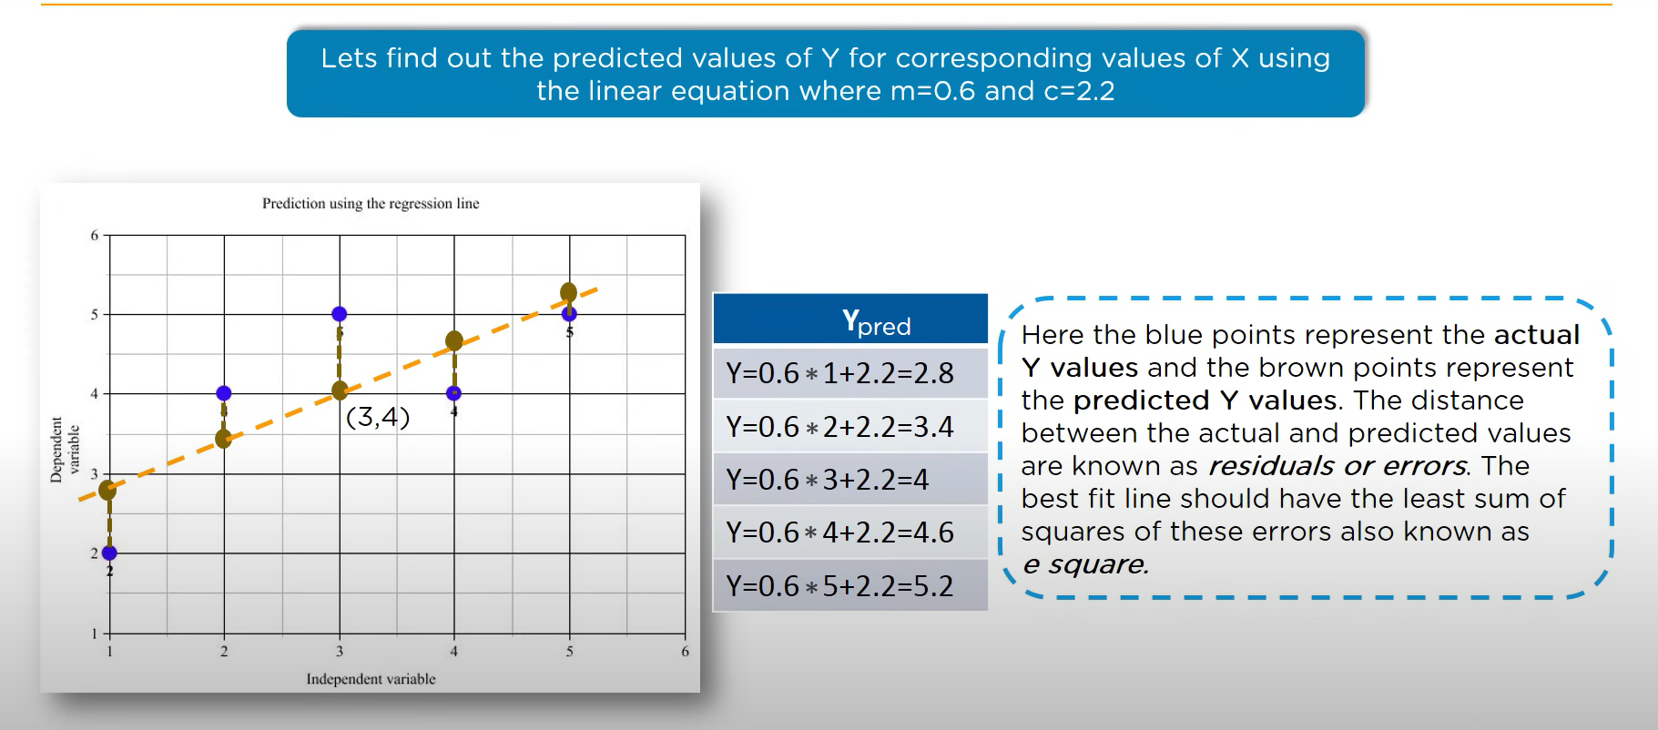
Find out predicted values

Slide 20
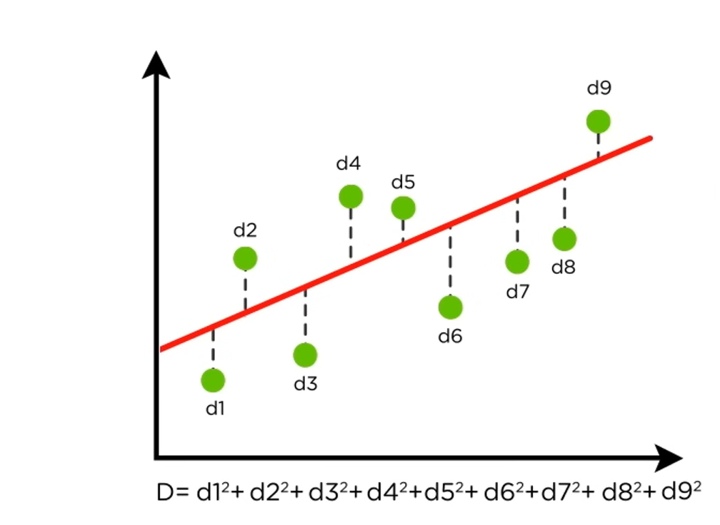
Finding the best fit line

Slide 21
To find the best Line
Inorder to find the best fit line ,we need to minimize the distance ,there are lots of ways to minimize the distance between line and datapoints like sum of squared erros, Root mean square etc
we need to move the best fit line through the datapoints to makesure the bestfit line has the least square distance between datapoints and regression line

Slide 22
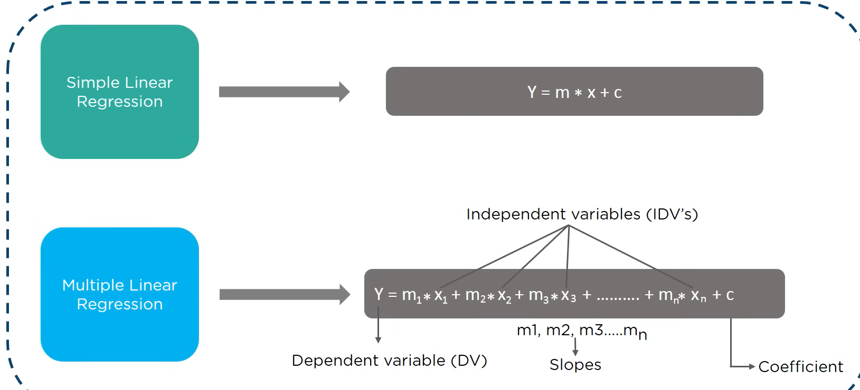
Multiple Linear Regression

Slide 23
Regression Analysis
Regression Analysis + Correlation = Predict future performance using past results
While Correlation explains the degree of linear relationship that exists between two variables, Regression defines the relationship more precisely
Regression analysis is a tool that uses data on relevant variables to develop a prediction equation, or model
It generates an equation to describe the statistical relationship between one or more predictors and the response variable and to predict new observations

Slide 24

Simple Linear Regression
Simple linear regression is useful for finding relationship between two continuous variables. One is predictor or independent variable and other is response or dependent variable.
It looks for statistical relationship but not deterministic relationship.
For example, relationship between height and weight.
In Simple Linear Regression, a single variable "X" is used to define/predict Y
E.g. Used car cost = B1 + (B2) x (Miles driven) + E (error)
Simple Regression Equation: Y = B1 + (B2) *(X)+ E (error)

Slide 25
Regression

Slide 26
Exp | Salary
2 | 50
4 | 70
3 | 55
9 | 75
12 | 120
14 | 150
10 | 75
2 | 40
6 | 80
6 | 70

Slide 27
Exp(Yrs) | Salary(KUSD)
2 | 50
4 | 70
3 | 55
9 | 75
12 | 120
14 | 150
10 | 75
2 | 40
6 | 80
6 | 70
https://stackoverflow.com/jobs/salary

Slide 28
Business Case :The Newspaper Data
In order to investigate the feasibility of starting a Sunday edition for a large metropolitan newspaper, information was obtained from a sample of 34 newspapers concerning their daily and Sunday circulations (in thousands)
Newspaper | daily | sunday | Newspaper | daily | sunday
Baltimore Sun | 391.952 | 488.506 | New York Daily News | 781.796 | 983.24
Boston Globe | 516.981 | 798.298 | New York Times | 1209.225 | 1762.015
Boston Herald | 355.628 | 235.084 | Newsday | 825.512 | 960.308
Charlotte Observer | 238.555 | 299.451 | Omaha World Herald | 223.748 | 284.611
Chicago Sun Times | 537.78 | 559.093 | Orange County Register | 354.843 | 407.76
Chicago Tribune | 733.775 | 1133.249 | Philadelphia Inquirer | 515.523 | 982.663
Cincinnati Enquirer | 198.832 | 348.744 | Pittsburgh Press | 220.465 | 557
Denver Post | 252.624 | 417.779 | Portland Oregonian | 337.672 | 440.923
Des Moines Register | 206.204 | 344.522 | Providence Journal-Bulletin | 197.12 | 268.06
Hartford Courant | 231.177 | 323.084 | Rochester Democrat & Chronicle | 133.239 | 262.048
Houston Chronicle | 449.755 | 620.752 | Rocky Mountain News | 374.009 | 432.502
Kansas City Star | 288.571 | 423.305 | Sacramento Bee | 273.844 | 338.355
Los Angeles Daily News | 185.736 | 202.614 | San Francisco Chronicle | 570.364 | 704.322
Los Angeles Times | 1164.388 | 1531.527 | St. Louis Post-Dispatch | 391.286 | 585.681
Miami Herald | 444.581 | 553.479 | St. Paul Pioneer Press | 201.86 | 267.781
Minneapolis Star Tribune | 412.871 | 685.975 | Tampa Tribune | 321.626 | 408.343
New Orleans Times-Picayune | 272.28 | 324.241 | Washington Post | 838.902 | 1165.567
Source: Gale Directory of Publications, 1994

Slide 29
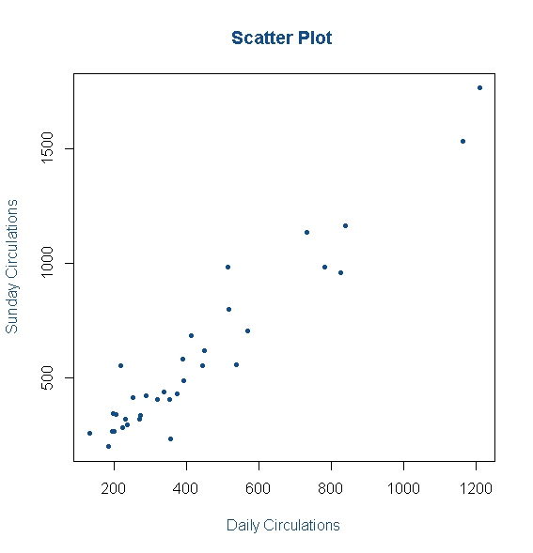
Scatter Plot: The Newspaper data

Slide 30
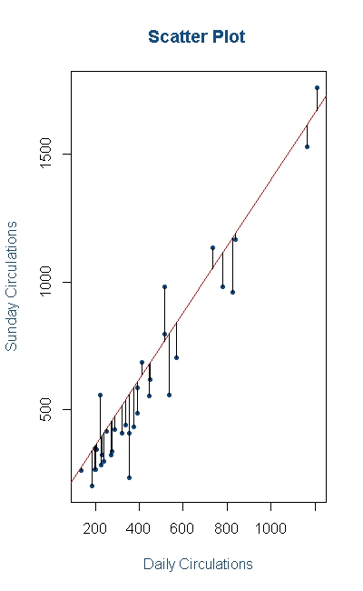
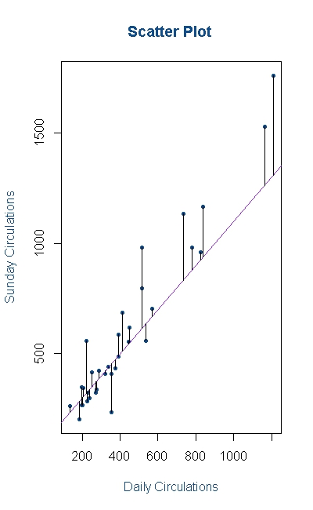
Which Straight Line? … The Newspaper data

Slide 31

The Best Line: Least Squares Method
The line of our interest is:

Slide 32
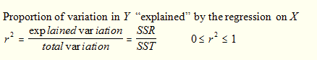
Coefficient of Determination R^2

Slide 33
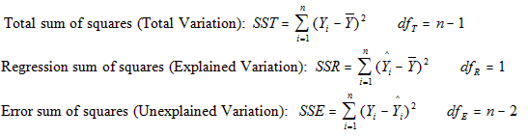
Measure of Variation
Sums of Squares
Total sum of squares = Regression sum of squares + Error sum of squares
Total variation = Explained variation + Unexplained variation

Slide 34
Let us do the Regression in Python

Slide 35
Simple Linear Regression: The Newspaper data
Regression Output
Coefficients | Estimate | t value | Pr(>|t|)
(Intercept) | 13.83563 | 0.386 | 0.702
daily | 1.33971 | 18.935 | <2e-16
Multiple R-squared: 0.9181, Adjusted R-squared: 0.9155
F-statistic: 358.5 on 1 and 32 DF, p-value: < 2.2e-16

Slide 36
Waist Circumference – Adipose Tissue
The Waist Circumference – Adipose Tissue business problem
Studies have shown that individuals with excess Adipose tissue (AT) in the abdominal region have a higher risk of cardio-vascular diseases
Computed Tomography, commonly called the CT Scan is the only technique that allows for the precise and reliable measurement of the AT (at any site in the body)
The problems with using the CT scan are:
Many physicians do not have access to this technology
Irradiation of the patient (suppresses the immune system)
Expensive
Is there a simpler yet reasonably accurate way to predict the AT area? i.e.
Easily available
Risk free
Inexpensive
A group of researchers¹ conducted a study with the aim of predicting abdominal AT area using simple anthropometric measurements i.e. measurements on the human body
The Waist Circumference – Adipose Tissue data is a part of this study wherein the aim is to study how well waist circumference(WC) predicts the AT area.
In-class Exercise

Slide 37
The Waist Circumference – Adipose Tissue data
Observation | Waist | AT | Observation | Waist | AT | Observation | Waist | AT
1 | 74.75 | 25.72 | 38 | 103 | 129 | 75 | 108 | 217
2 | 72.6 | 25.89 | 39 | 80 | 74.02 | 76 | 100 | 140
3 | 81.8 | 42.6 | 40 | 79 | 55.48 | 77 | 103 | 109
4 | 83.95 | 42.8 | 41 | 83.5 | 73.13 | 78 | 104 | 127
5 | 74.65 | 29.84 | 42 | 76 | 50.5 | 79 | 106 | 112
6 | 71.85 | 21.68 | 43 | 80.5 | 50.88 | 80 | 109 | 192
7 | 80.9 | 29.08 | 44 | 86.5 | 140 | 81 | 103.5 | 132
8 | 83.4 | 32.98 | 45 | 83 | 96.54 | 82 | 110 | 126
9 | 63.5 | 11.44 | 46 | 107.1 | 118 | 83 | 110 | 153
10 | 73.2 | 32.22 | 47 | 94.3 | 107 | 84 | 112 | 158
11 | 71.9 | 28.32 | 48 | 94.5 | 123 | 85 | 108.5 | 183
12 | 75 | 43.86 | 49 | 79.7 | 65.92 | 86 | 104 | 184
13 | 73.1 | 38.21 | 50 | 79.3 | 81.29 | 87 | 111 | 121
14 | 79 | 42.48 | 51 | 89.8 | 111 | 88 | 108.5 | 159
15 | 77 | 30.96 | 52 | 83.8 | 90.73 | 89 | 121 | 245
16 | 68.85 | 55.78 | 53 | 85.2 | 133 | 90 | 109 | 137
17 | 75.95 | 43.78 | 54 | 75.5 | 41.9 | 91 | 97.5 | 165
18 | 74.15 | 33.41 | 55 | 78.4 | 41.71 | 92 | 105.5 | 152
19 | 73.8 | 43.35 | 56 | 78.6 | 58.16 | 93 | 98 | 181
20 | 75.9 | 29.31 | 57 | 87.8 | 88.85 | 94 | 94.5 | 80.95
21 | 76.85 | 36.6 | 58 | 86.3 | 155 | 95 | 97 | 137
22 | 80.9 | 40.25 | 59 | 85.5 | 70.77 | 96 | 105 | 125
23 | 79.9 | 35.43 | 60 | 83.7 | 75.08 | 97 | 106 | 241
24 | 89.2 | 60.09 | 61 | 77.6 | 57.05 | 98 | 99 | 134
25 | 82 | 45.84 | 62 | 84.9 | 99.73 | 99 | 91 | 150
26 | 92 | 70.4 | 63 | 79.8 | 27.96 | 100 | 102.5 | 198
27 | 86.6 | 83.45 | 64 | 108.3 | 123 | 101 | 106 | 151
28 | 80.5 | 84.3 | 65 | 119.6 | 90.41 | 102 | 109.1 | 229
29 | 86 | 78.89 | 66 | 119.9 | 106 | 103 | 115 | 253
30 | 82.5 | 64.75 | 67 | 96.5 | 144 | 104 | 101 | 188
31 | 83.5 | 72.56 | 68 | 105.5 | 121 | 105 | 100.1 | 124
32 | 88.1 | 89.31 | 69 | 105 | 97.13 | 106 | 93.3 | 62.2
33 | 90.8 | 78.94 | 70 | 107 | 166 | 107 | 101.8 | 133
34 | 89.4 | 83.55 | 71 | 107 | 87.99 | 108 | 107.9 | 208
35 | 102 | 127 | 72 | 101 | 154 | 109 | 108.5 | 208
36 | 94.5 | 121 | 73 | 97 | 100
37 | 91 | 107 | 74 | 100 | 123

Slide 38
Thank you

